Slide 1
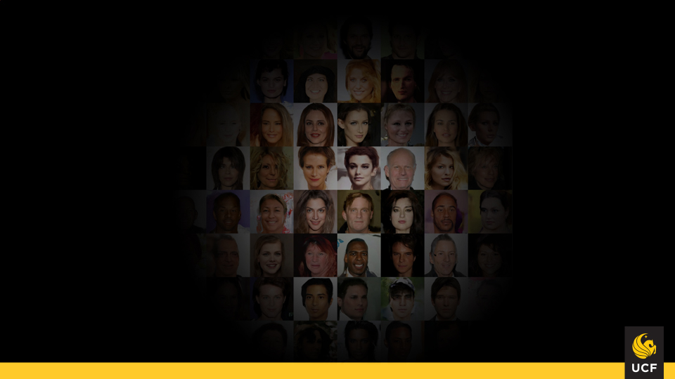
Generating High Fidelity Images with Subscale Pixel Networks and Multidimensional Upscaling.
A paper by:
Jacob Menick
Nal Kalchbrenner
Presented by:
Kesar TN
Professor: Ulas Bagci
CAP 6614 – Fall ‘19
Notes:
JHjHGVLJHGLG

Slide 2

Contents:
Goals and Motivation
Deep Generative models
Autoregressive models
What this paper offers?
Subscale Pixel Networks architecture
How we subscale?
Negative Log-likelihood
Results
Paper achievements
References

Slide 3
Goals and Motivation:
Goals:
Building a deep Autoregressive decoder that can unconditionally generate high-fidelity images
Motivation:
Capacity to encode vast previous context used to generate images
Difficulty of learning a distribution that preserves both global semantic coherence and exactness of details

Slide 4
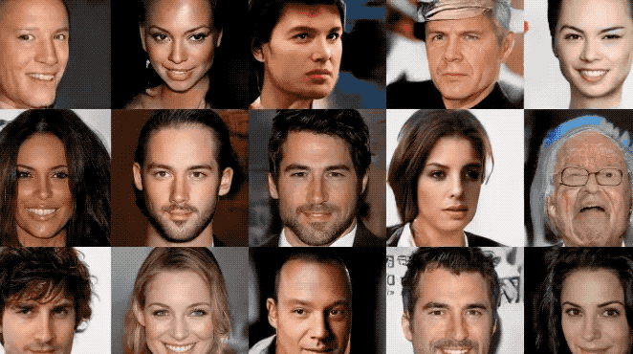
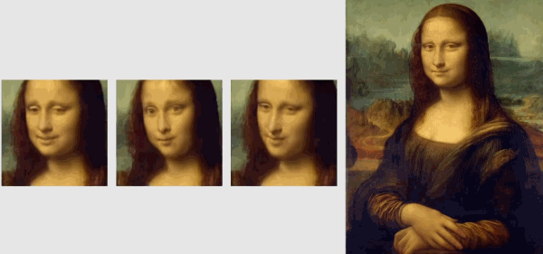
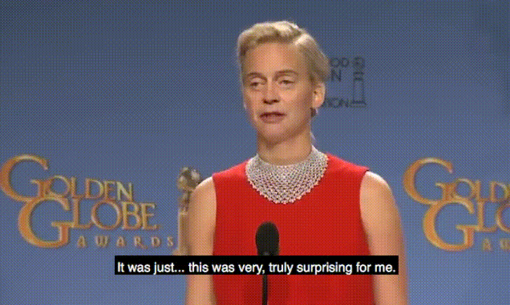
What can these Generative models achieve?

Slide 5
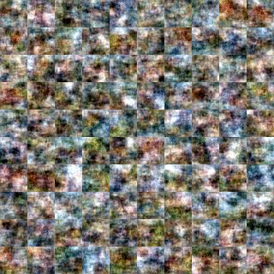
Deep Generative models:
Variational Autoencoder (VAE)
Generative Adversarial Network (GAN)
Autoregressive Model (AR)
PixelRNN LSTM
PixelCNN Masked Convolution
Gated PixelCNN Gated Convolution
Image Transformer Self-Attention
Pixel SNAIL Self-Attention and Gated convolution
https://openai.com/blog/generative-models/

Slide 6

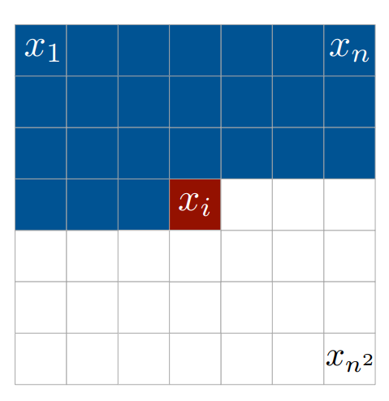
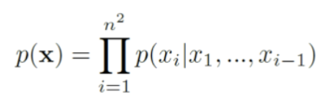

Autoregressive Models:
AR models treat an image as a sequence of pixels and represent its probability as the product of the conditional probabilities of all pixels.
To generate pixel $x_{i}$
https://towardsdatascience.com/auto-regressive-generative-models-pixelrnn-pixelcnn-32d192911173

Slide 7
Autoregressive Models:
Advantages:
Likelihood-based model
Direct negative log-likelihood calculation
Intrinsic measure of generalization
Captures entire data distribution
Stable Training
Disadvantages:
Capacity to encode the vast previous context
Large memory and computation requirement
Learning a distribution that preserves global semantic coherence and exactness of detail

Slide 8
What the paper offers?
Subscale Pixel Network (SPN):
A conditional decoder architecture that generates an image as a sequence of sub-images of equal sizes (Slices)
Multidimensional Upscaling:
Upscaling not just height and width of the image, but also in the remaining dimensions i.e channel depth

Slide 9
What the paper offers?
A Subsampling Decoder on a small size, low depth image slices subsampled at every N pixels from the original image with target resolution
A Size-Upscaling Decoder that generates the large size, low depth image conditioned on the small size, low depth image
A Depth-Upscaling Decoder that generates the large size, high depth image conditioned on the large size, low depth image.

Slide 10
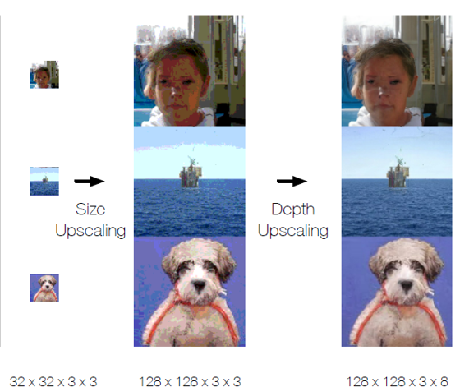
What the paper offers?

Slide 11
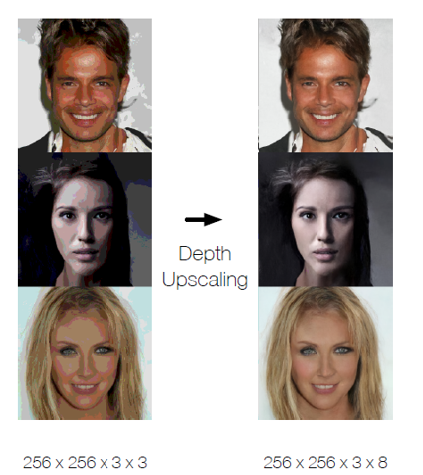
What the paper offers?

Slide 12
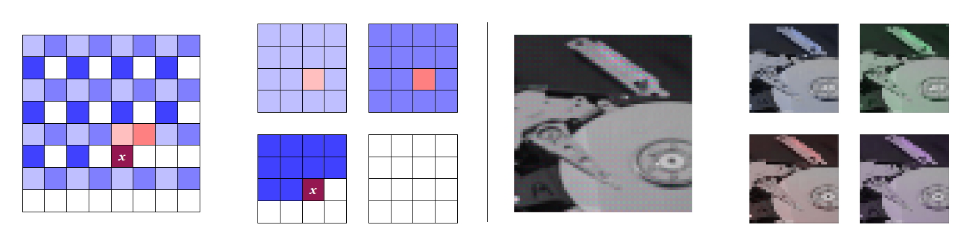



Subscale Pixel Network (SPN) architecture
The SPN divides an image of size NxN into sub-images of size $\frac{N}{S}×\frac{N}{S}$sliced out at interleaving positions, which implicitly also captures a form of size upscaling
Original 8x8 image
4x4 slices
Original 8x8 image
4x4 slices
$$N×N$$
$$\frac{N}{S}×\frac{N}{S}$$
$$N×N$$
$$\frac{N}{S}×\frac{N}{S}$$

Slide 13
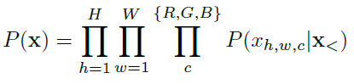
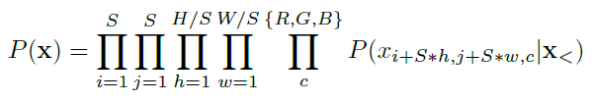
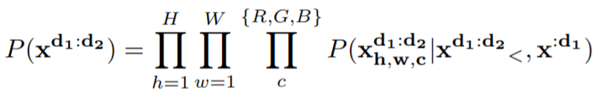
How do we subscale?
Conventional Generation Ordering
Subscale Ordering
Depth Upscaling

Slide 14
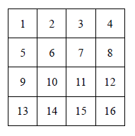
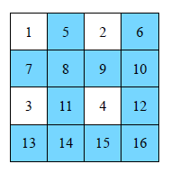
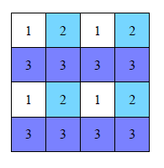
How do we subscale?
Conventional
Multi-scale
Parallel
Multi-scale
Conventional

Slide 15
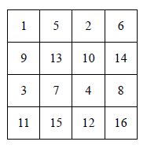
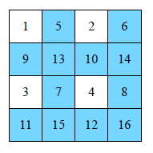
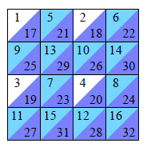
How do we subscale?
Subscale +
Size upscaling
Subscale +
Depth upscaling
Conventional
Subscale
Separate network for initial size
Separate network for initial size
Separate network for MSB and LSB

Slide 16
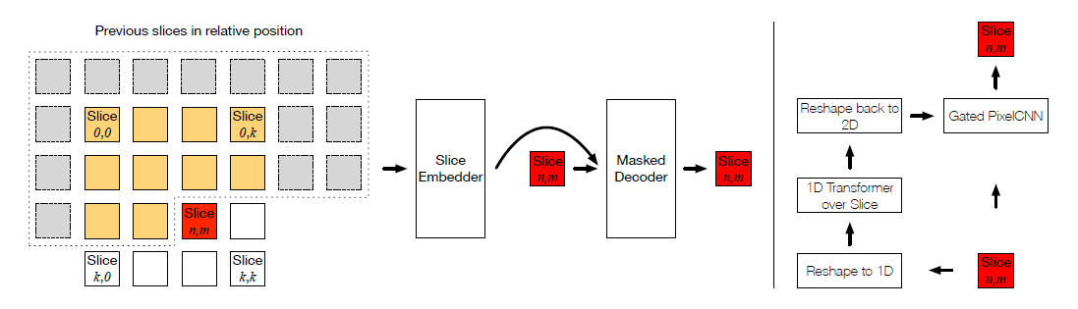
Subscale Pixel Network:
Subscale Pixel
Network
Masked Decoder
32 x 32 x 3 x D

Slide 17
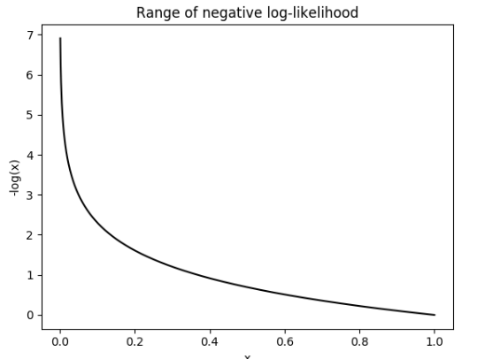
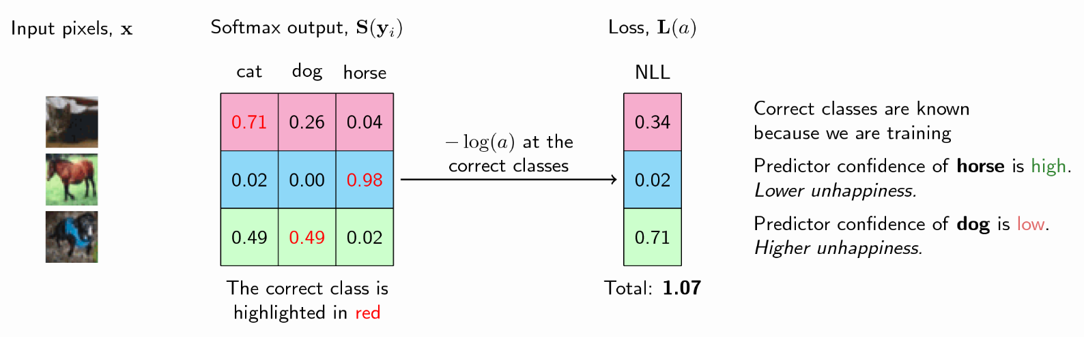

Negative Log-Likelihood (NLL):
NLL is the unhappiness of the network with respect to its parameters.
The higher the loss, the higher the unhappiness.
$$L\left(y\right)=−\log\left(y\right)$$
https://ljvmiranda921.github.io/notebook/2017/08/13/softmax-and-the-negative-log-likelihood/

Slide 18
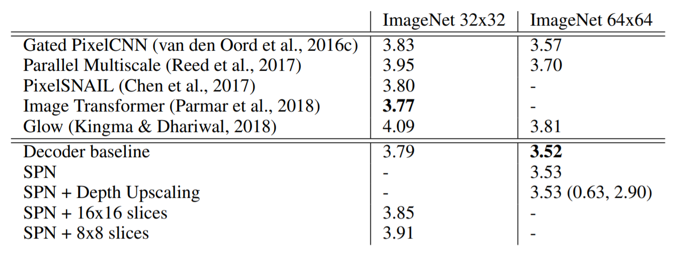
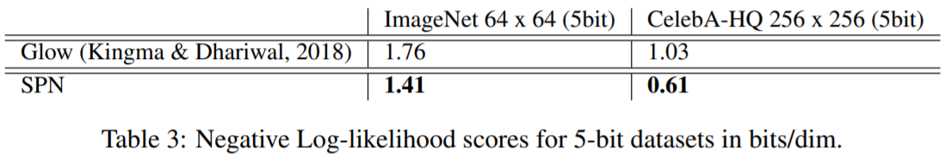
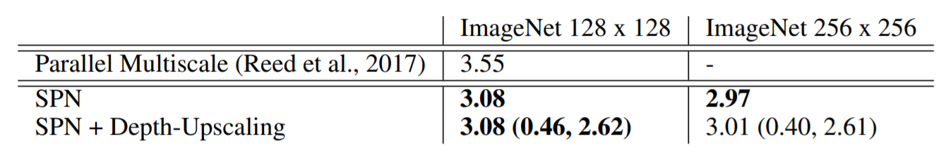
Results:
Losses in NLL in bits/dim

Slide 19
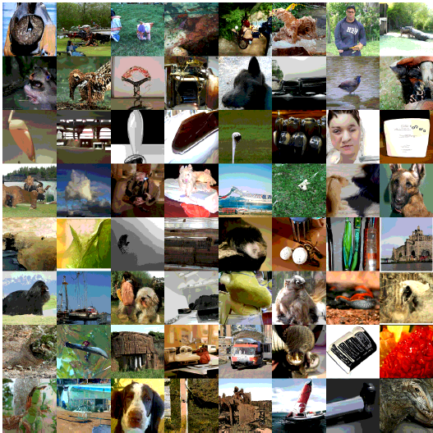
Results:
128x128 3-bit ImageNet from SPN

Slide 20
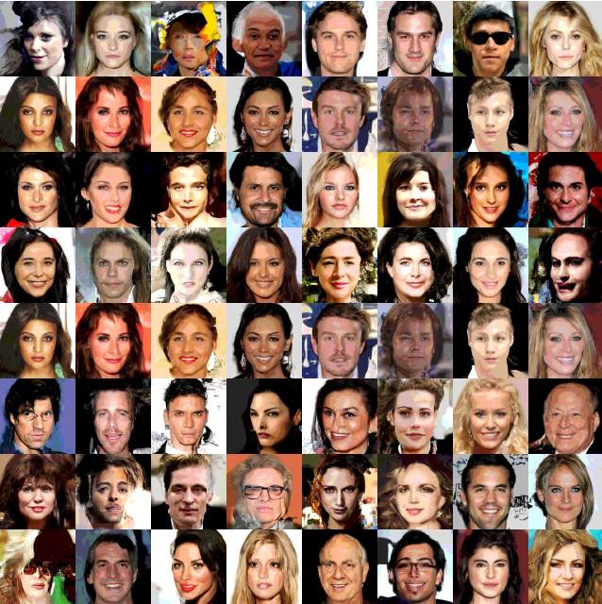
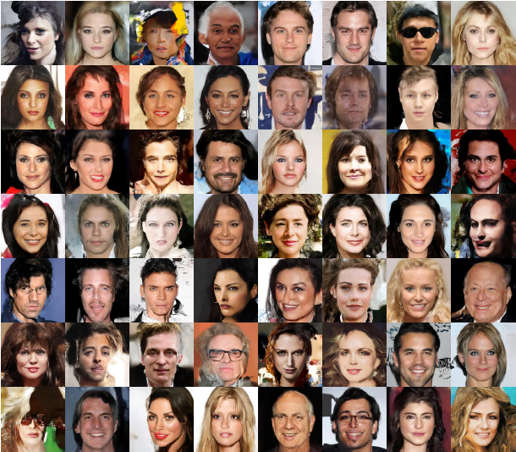
Results:
256x256 3-bit CelebA-HQ
256x256 8-bit CelebA-HQ

Slide 21
Main Results:
Unconditionally generate images up to size 256x256 pixels and assess the fidelity of generated images.
Improve state-of-the-art negative log-likelihoods on ImageNet images at 128x128 pixels by a large margin (3.08 bits/dim). Down from 3.55 bits/dim
First negative log-likelihood benchmark on 256x256 pixel ImageNet images (2.97 bits/dim without depth-upscaling and 3.01 bits/dim with depth-upscaling)

Slide 22
Questions?

Slide 23
References
Jacob Menick, Nal Kalchbrenner, GENERATING HIGH FIDELITY IMAGES WITH SUBSCALE PIXEL NETWORKS AND MULTIDIMENSIONAL UPSCALING, URL: https://arxiv.org/abs/1812.01608
Xi Chen, Nikhil Mishra, Mostafa Rohaninejad, and Pieter Abbeel. PixelSNAIL: An improved autoregressive generative model. CoRR, abs/1712.09763, 2017. URL http://arxiv.org/abs/ 1712.09763.
https://towardsdatascience.com/generating-high-resolution-images-using-autoregressive-models-3683f9af0db4
https://ljvmiranda921.github.io/notebook/2017/08/13/softmax-and-the-negative-log-likelihood
https://en.wikipedia.org/wiki/List_of_monochrome_and_RGB_palettes#3-bit_RGB
https://towardsdatascience.com/auto-regressive-generative-models-pixelrnn-pixelcnn-32d192911173

Slide 24


